Slide 1


Unlocking Value: A Deep Dive into Credit Card Portfolio Performance
Presented by: Sakshi Hulke

Slide 2
Agenda: Navigating Our Analysis
01
02
Introduction & Objectives
Dataset Overview
Setting the stage for our credit card portfolio analysis.
Understanding the foundational data driving our insights.
03
04
SQL Data Preparation
Key Performance Indicators (KPIs)
The crucial steps in transforming raw data into actionable intelligence.
Defining and calculating the metrics that matter most.
05
06
Dashboard Visualizations
Key Insights
Bringing data to life through intuitive and informative dashboards.
Uncovering critical patterns and trends from our analysis.
07
08
Strategic Recommendations
Conclusion & Next Steps
Actionable strategies to optimize portfolio performance.
Summarizing our findings and outlining future directions.

Slide 3
Dataset Overview: Our Foundation of Analysis
Our analysis is built upon a comprehensive dataset comprising transactional records, customer demographics, and credit account details over the past 12 months. This rich data provides a 360-degree view of our credit card portfolio, enabling us to identify patterns in customer behavior, spending habits, and risk profiles.
Key Data Points:
The dataset contains over 1.5 million individual transactions from 250,000 active credit card accounts. Data integrity and completeness were rigorously checked, ensuring a reliable basis for our analysis. This granular level of detail is crucial for uncovering nuanced trends and formulating targeted strategies.
Customer ID: Unique identifier for each cardholder.
Transaction Date: Timestamp of each purchase/payment.
Transaction Amount: Value of each transaction.
Merchant Category: Type of merchant (e.g., retail, dining).
"Data is the new oil." - Clive Humby, underscores the critical importance of our robust dataset in driving meaningful insights.
Credit Limit: Assigned spending limit for each account.
Balance: Outstanding balance on the account.
Payment Status: Current status (e.g., on time, delinquent).
Age & Income: Demographic information for segmentation.

Slide 4
SQL Data Preparation: Transforming Raw into Ready
Effective analysis hinges on clean, well-structured data. Our SQL data preparation phase involved several critical steps to transform the raw transactional and account data into a format suitable for robust KPI calculation and dashboard visualization.
Key Transformation Steps:
-- Example SQL for Monthly Spending Aggregation SELECT CustomerID, DATE_TRUNC('month', TransactionDate) AS Month, SUM(TransactionAmount) AS TotalMonthlySpend FROM Transactions GROUP BY CustomerID, Month ORDER BY CustomerID, Month;
Data Cleaning: Handling missing values, removing duplicates, and correcting data types for consistency.
Feature Engineering: Creating new variables like "Days_Since_Last_Transaction" or "Average_Monthly_Spend" to enrich the dataset.
Aggregation: Summarizing transactional data by customer or month to enable high-level analysis.
Joins: Merging customer demographics with transaction and account data to create a unified view.
Segmentation: Applying criteria to categorize customers (e.g., by credit score, spending tiers).
This meticulous process ensures data accuracy and relevance, providing a solid foundation for our subsequent analytical work. Without proper preparation, even the most advanced analytical models would yield unreliable results.

Slide 5






Key Performance Indicators (KPIs): Measuring Success
To assess the health and performance of our credit card portfolio, we focused on a set of crucial Key Performance Indicators (KPIs). These metrics provide a clear picture of customer engagement, financial stability, and revenue generation.
Average Monthly Spend
Revolving Balance Ratio
Indicates customer spending habits and portfolio utilization. A higher average spend points to active card usage.
The percentage of customers carrying a balance month-to-month, crucial for interest revenue forecasting.
Customer Churn Rate
Delinquency Rate
Measures the rate at which customers close accounts or become inactive, highlighting retention challenges.
The proportion of accounts with overdue payments, a key indicator of credit risk and potential losses.
New Accounts Activated
Interchange Revenue
Tracks growth in the customer base, essential for portfolio expansion and market penetration.
Revenue generated from transaction processing, directly linked to spending volume.
Monitoring these KPIs allows us to identify trends, pinpoint areas of concern, and measure the impact of strategic initiatives on the portfolio's overall performance and profitability.

Slide 6
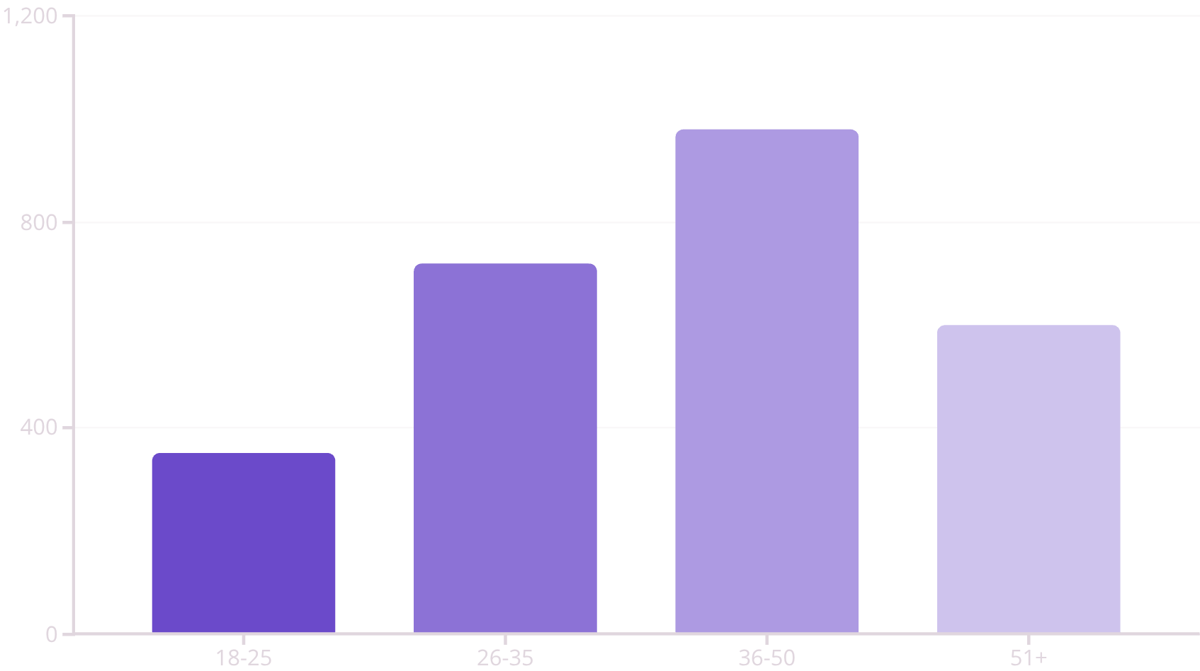
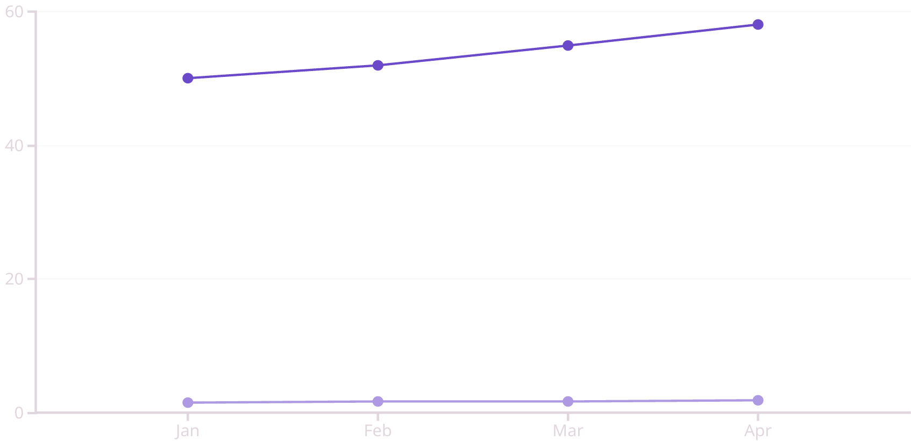
Dashboard Visualizations: At-a-Glance Insights
Our interactive dashboards transform complex data into clear, actionable visuals. These dashboards enable stakeholders to quickly grasp the portfolio's performance, identify trends, and drill down into specific areas of interest.
Portfolio Performance Overview
Customer Segmentation & Behavior
This dashboard provides a high-level summary of key financial metrics, including total outstanding balance, average credit utilization, and overall revenue. It's designed for executive-level oversight.
Visualizes customer segments by age, income, and spending patterns. It highlights the most profitable customer groups and areas for targeted marketing.
Total Balance (M)
Total Revenue (M)
These dashboards are built for accessibility and dynamic interaction, allowing for real-time adjustments and deeper explorations of the data.

Slide 7
Key Insights: Uncovering Opportunities
Our analysis revealed several critical insights into the credit card portfolio's performance and customer behavior, pointing to both strengths and areas for strategic intervention.
Surge in Digital Transactions
Increased Delinquency in Younger Segments
There's been a 30% increase in online and mobile wallet transactions over the last quarter, indicating a strong shift towards digital payment methods among cardholders. This presents an opportunity for targeted digital engagement.
The 18-25 age group shows a 15% higher delinquency rate compared to other segments, suggesting a need for tailored financial literacy programs or stricter initial credit assessments for this demographic.
High Churn in Low-Activity Accounts
Seasonal Spending Peaks
Accounts with less than 3 transactions per month exhibit a 20% higher churn rate. These inactive accounts are prone to closure, highlighting a need for re-engagement strategies.
Significant spending peaks are observed during holiday seasons (Nov-Dec) and summer months (Jul-Aug), particularly in travel and retail categories. This confirms opportunities for seasonal promotional campaigns.
These insights serve as a foundation for developing targeted strategies to enhance portfolio profitability, reduce risk, and improve customer satisfaction.

Slide 8
Strategic Recommendations: Driving Growth and Stability
Based on our key insights, we propose the following strategic recommendations to optimize the credit card portfolio, enhance customer value, and mitigate risks.
1
Enhance Digital Engagement Platforms
Invest in a more intuitive mobile banking app and online portal to facilitate digital transactions and customer self-service, capitalizing on the surge in digital usage.
2
Implement Targeted Financial Literacy Programs
Develop educational content and resources specifically for the 18-25 age group, focusing on responsible credit usage to reduce delinquency rates.
3
Proactive Low-Activity Account Re-engagement
Launch personalized campaigns (e.g., bonus points for first transaction in 3 months, special offers) to incentivize inactive cardholders to re-engage and prevent churn.
4
Optimize Seasonal Promotional Strategies
Leverage identified spending peaks with timely and relevant credit card promotions, loyalty programs, and partnerships in high-spending categories like travel and retail.
5
Strengthen Fraud Detection & Prevention
Continuously update and improve AI-driven fraud detection systems to protect customers and reduce financial losses, building trust and security.
These recommendations are designed to be actionable and measurable, aiming to yield significant improvements in portfolio performance and customer satisfaction.

Slide 9
Conclusion & Next Steps
Our deep dive into the credit card portfolio has provided invaluable insights into performance trends, customer behavior, and areas ripe for optimization. By leveraging data-driven strategies, we can enhance profitability, reduce risk, and foster stronger customer relationships.
Key Takeaways
Immediate Next Steps
Digital shift is significant.
Prioritize digital engagement initiatives.
Youth segment requires attention.
Pilot financial literacy program for youth.
Inactive accounts are high churn risk.
Launch re-engagement campaign for inactive users.
Seasonal patterns offer opportunities.
Develop Q4 seasonal promotion plan.
We are committed to continuously monitoring these metrics and adapting our strategies to ensure the sustained success and growth of our credit card portfolio.

